Slide 1
計算機概論homework2
111304003
統計二 柯冠宇

Slide 2
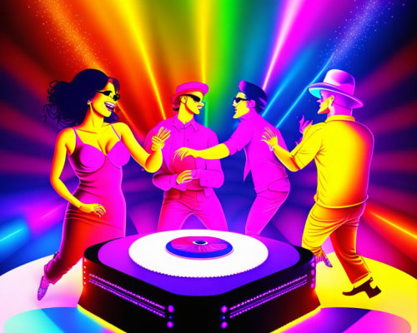
picture1
Prompt:
a party,disco,a dj some people are dancing,cartoon style

Slide 3
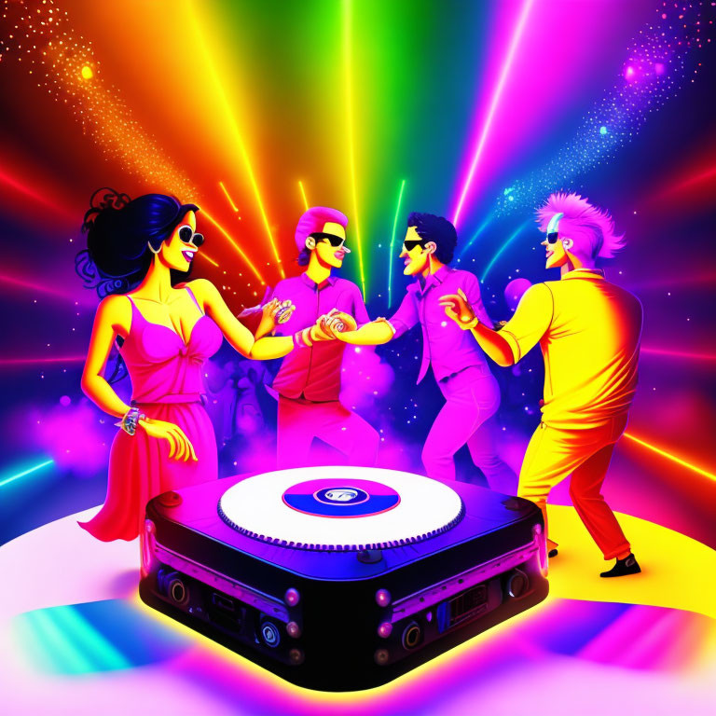
picture2
Add elements: some people are drinking beer

Slide 4
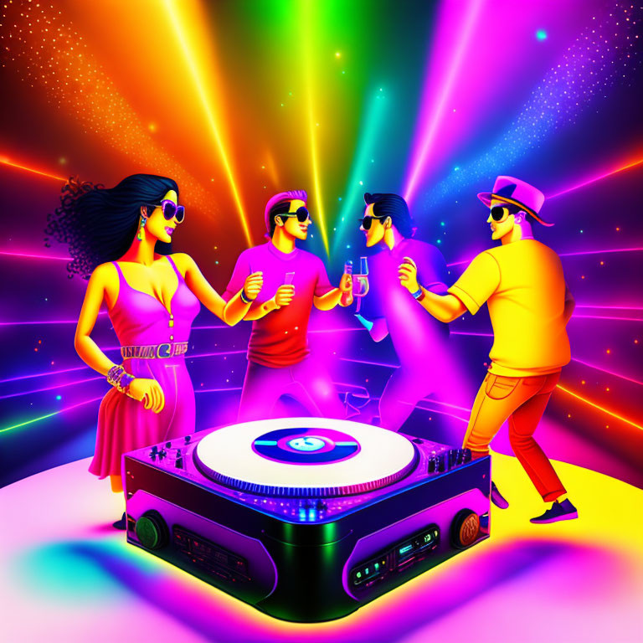
picture3
Add prompt:
make the overall details more natura

Slide 5
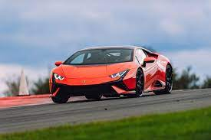
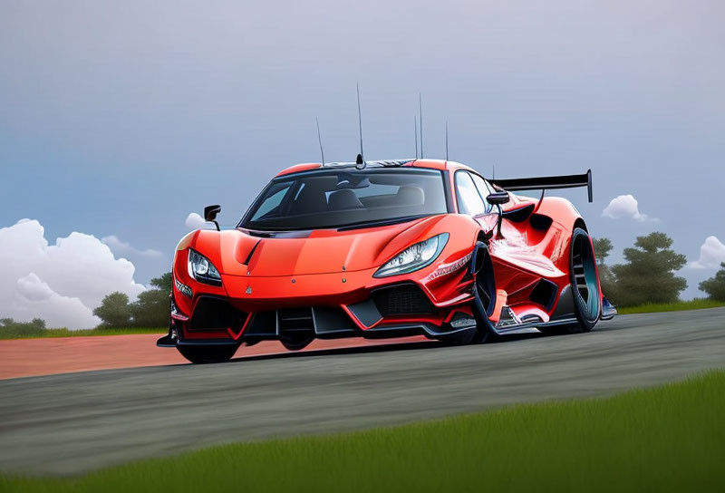
picture4
Prompt : let the car be the cartoon style and detail looks natural

